Slide 1
Chapter 11 Routing Protocols
Interior and exterior routing
Distance vector routing & RIP
Link state routing & OSPF
Path vector routing & BGP-4

Slide 2
Introduction
Convergence
Overhead
Scalability
Routing Table
Static route ← manually define
Dynamic route ← routing protocol
Table-driven routing
One router ←→ More routed protocols
One routed protocol ←→ One routing table
One routed protocol ←→ More routing protocols
Routing protocol
To share the knowledge about the internet
To calculate the routing table based on the topology or the policies
Notes:
收敛，成本，可扩展

Slide 3
Metric（度量）
Information used by a routing protocol to select the best path for routing
The total metric of a route = the sum of the metrics of networks that comprise the route
A router chooses the route with the shortest metric
Factors
Hop count, bandwidth, delay, MTU, load, reliability, …
Routing protocols can use one or more different factors to calculate a metric
A
64K
64K
Hop count: A → B → Net
Bandwidth: A → C → D → Net
B
Net
C
D
10M
10M
10M

Slide 4
Convergence（收敛）
Convergence
All routers in a network agree on the topology
Convergence time
A measure of how quickly to recover from network changes
Factors affecting convergence
The routing protocol used
A router’s distance from the point of change
The number of routers in the network
Bandwidth and traffic load on communications links
A router’s load
Traffic patterns in relation to the topology change

Slide 5
11.1 Interior & Exterior Routing
Autonomous system（自治系统，AS）
A group of networks and routers under the authority of a single administration
Each AS typically represents an independent organization and applies its own unique routing and security policies
AS number
An identifying number that is assigned by an Internet registry or a service provide
Range: 1~65535
Private AS number: 64512~65535

Slide 6
IGP vs. EGP
IGP: Interior Gateway Protocol（内部网关协议）
To be used within an autonomous system
To find the best path to the network
Example：RIP、OSPF、IS-IS
EGP: Exterior Gateway Protocol（外部网关协议）
To be used between autonomous systems
To find the best path to the AS
Example：BGP-4
Note
The static routing or an IGP could also be used between autonomous systems in some case
AS1
EGP
AS2
IGP
R
R
IGP

Slide 7
Routing Protocols
Protocol | Type | Routing method | Popular ver.
RIP | IGP | Distance vector routing | RIPv1, RIPv2
OSPF | IGP | Link state routing | OSPFv2
BGP | EGP | Path vector routing | BGP4
Routing protocols
Concept of the routing method
Features and messages
Operation

Slide 8
11.2 Distance Vector Routing
Initialization
Directed routes: directed network & metric
Sharing the knowledge about the internet
What the routing table – network & metric
Where only with the immediate neighbors
When periodical & triggered
Updating the routing table
提供了指向网络的路标 ！

Slide 9
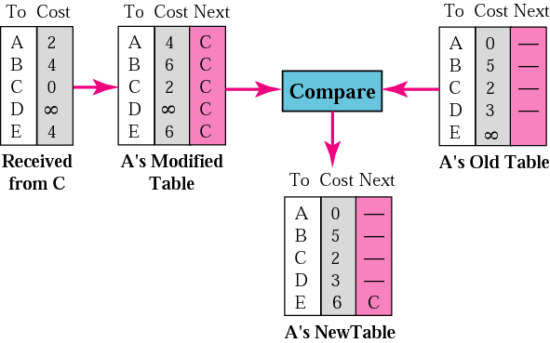
Updating
①
②
③
5
A
B
2
4
3
C
3
4
D
E

Slide 10
Routing Loop: Two-node instability
You can reach net1 through me with length 2
B can reach net1 ! Great !
Hop count changed !
Hop count changed !
A: ( net1, 3 )
B: ( net1, 2 )
B: ( net1, 4 )
Net 1
Net 2
Net 3
A
B
Routing table
Routing table
-
-
1
∞
∞
Net1
…… | … | …
Net1 |  | A
…… | … | …
2
4
B
3
16

Slide 11
Some Remedies for Instability
Defining infinity（定义无穷大）
Use a finite metric value to represent "infinity“
The value must be large enough that no real metric would ever get that large
Triggered update（触发更新）
Split horizons（水平分割）
Poison reverse（毒性逆转）
A variation of split horizons
None of them are 100% effective !

Slide 12
Triggered Update
An attempt to speed up the convergence
If there are no changes on the network
To send update messages at usual 30-s intervals
If there is a change
To send update messages almost immediately
Special handling in RIP
To limit the frequency of triggered updates
Set a timer for a random time between 1 and 5 s
A single update is triggered when the timer expires
To limit the routes included in triggered updates
At least those changed routes

Slide 13
Split Horizons
RIP messages
Net2 1
Net1 1
Net3 2
B
Net 1
Net 2
Net 3
A
Net1 2
Net3 1
Net2 1
RIP messages
Notes:
分割范围，只交换 该端口之外的连接信息，如路由器A给B的信息只有Net1 1

Slide 14
Poison Reverse
RIP messages
Disadvantage:
Increasing the size of
the routing messages
Net1 16
Net1 1
Net2 1
Net2 16
Net3 2
Net3 16
B
Net 1
Net 2
Net 3
A
Net1 16
Net1 2
Net2 16
Net2 1
Net3 1
Net3 16
RIP messages
Notes:
一直删除某端口的信息，会造成 该节点链路断开 与 分割范围机制的混淆，因此加入 Poison Reverse机制，将交换信息的本端口反向度量设置为无穷大(usually 16),”不要使用这个数值，因为我所知道的数值来源于你”

Slide 15
More-node instability
E
Net 1
1. Net 1 unreachable, then E sends a triggered
update to its neighbor A
2. Then A knows Net 1 is unreachable from E,
then sends a triggered update only to neighbors
B and D because of the split horizons
3. B and D know Net unreachable from A, then send a triggered update only to the neighbor C because of the split horizons
4. Assume that C has known about Net 1 from B, and C sends a regular update about Net 1 is accessible to D before the triggered update has been received.
5. Then D think Net 1 can be reachable through C, so D updates its routing table and informs A → routing loop
A
D
B
C

Slide 16
Hold-down Timer, 抑制定时器
To prevent update messages from reinstating inaccessible routes —— not in RFC
When a router receives an update that indicates a network is unreachable, it starts a hold-down timer ( 180 s )
While the hold-down timer is running, the router will NOT accept any update about the inaccessible route UNLESS
the update comes from the originator of the previously inaccessible update
or from a router reporting a better metric to the inaccessible network
Notes:
1.更新计时器（update）：30S更新路由表；2.无效计时器（invalid）：180S不刷新则将该路由条目的度量值设置为16；
3.刷新计时器（flush）：默认240S，比无效计时器长60S，刷新后路由条目则删除；4.抑制计时器（Hold-down）：180S。

Slide 17
11.3 RIP
RIP = RIPv1
Routing Information Protocol，RIP
v1：RFC 1058，v2：RFC 2453，路由信息协议
Application
Layer
RIP
软件实现层次
520
Transport
Layer
TCP
UDP
Network
Layer
ICMP
IGMP
IP
ARP
RARP
Network
Access Layer
LANs
MANs
WANs
Notes:
RIP是一个应用层协议，基于UDP，端口号为520

Slide 18
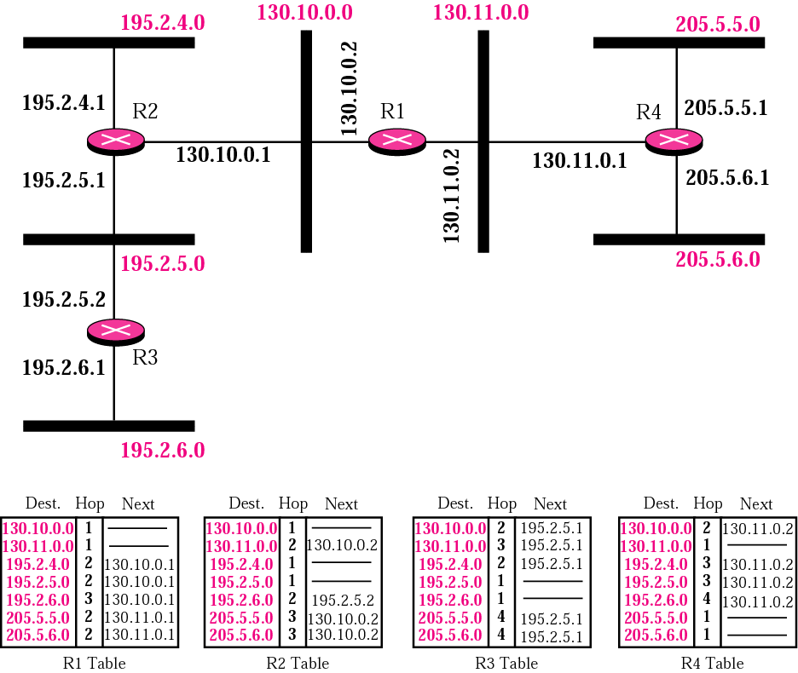
Example of a domain using RIP
Metric: hop count（跳数）
Infinity = 16, means unreachable
The maximum hop count = 15
Notes:
Hops个数，也意味着delivery次数，无穷大被定义为16，则最大跳数不能超过15

Slide 19
11.3.1 RIP Message
Format ( <=512 bytes )
Encapsulation: UDP ( port 520 )
Command
Version
All 0s
Family = 2
All 0s
IP address
Repeated
All 0s
All 0s
Metric ( hop count )
Notes:
命令字段指明报文类型，请求(1)或响应(2)，RFC中原本还有3 4 已被废弃不用，5用于Sun Microsystems， 8bits版本号，目前有2个版本 V1和V2，本章讨论V1，family/系列，2为TCP/IP，14个字节的网络地址，目前只用到 IP address4字节，Metrics为hops，该表格称为1个表项entry

Slide 20
Types of Messages
Request ( Command = 1 ): broadcast
All entries ( IP address = 0.0.0.0 )
To be sent by a router that has just come up
Specific entries ( IP address ≠ 0.0.0.0 )
To be sent by a router that has some time-out entries
Response ( Command = 2 )
Solicited: unicast to the asker
To be sent only in answer to a request
Unsolicited: broadcast to every neighbor
To be sent every 30 s, contain the entire routing table
Notes:
特定项目请求/所有项目请求， 询问的响应，非询问响应

Slide 21
11.3.2 RIP Operation
Discovery
Topology change
Calculating
RIP updating algorithm
Split horizons & poison reverse
Initialize
RT
Send
RT
Update?
No
Send RT per 30s
Yes
Update RT
Find the change
Update
RT
Send RT
on schedule
Like discovery
Triggered update

Slide 22
Initializing the Routing Table
Only the directly attached networks
RFC 1058: metric = 1
In most routers: metric = 0
Examples of some router’s routing table
Cisco router
C 10.1.1.0 is directly connected, FastEthernet0/0
华为 router
Dst/Mask Proto Pref Metric Nexthop Interface
10.1.1.0/24 Direct 0 0 10.1.1.254 Ethernet0
RFC 1058: section 3.6
……
……
Notes:
本地局域网10.1.1.0 ，Pref 用于多路由协议中的优先级，值越小则优先级越高，0表示直接路由

Slide 23
RFC 1058: Sending RIP Responses
Source IP address
The IP address of the sending interface
Consider: multiple IP addresses on a single physical interface
The entries
Answer to a request: the requested routes
Regular update: the whole routing table
Triggered update: only the changed routes
Note: the max datagram size is 512 bytes
In each entry
Address: host addr, subnet addr, network addr, 0.0.0.0
Metric: from the routing table without change
Notes:
RFC 1058: section 3.4.2，“在路由设置两个虚拟接口192.168.0.1(/24)及192.168.1.1(/24)如果从192.168.0.0网络访问路由器该路由的主接口就是192.168.0.1,如果通过192.168.1.0网络访问该路由器,该路由器的主接口为192.168.1.1”

Slide 24
RFC 1058: Updating the Routing Table
When receive a response RIP message
First to check for validity
Port number, source IP address
Then to process the entries in it one by one
1. Ignore the entry whose metric, address or unused fields are invalid
2. Update the entry’s metric = min ( metric + 1, 16 )
3. If the entry address is not in the RT, then add it
4. Else if the next-hop in the RT is same with source IP address, then replace the route in the RT with this entry
5. Else if the new metric is lower than the one in the RT, then replace the route in the RT with this entry

Slide 25
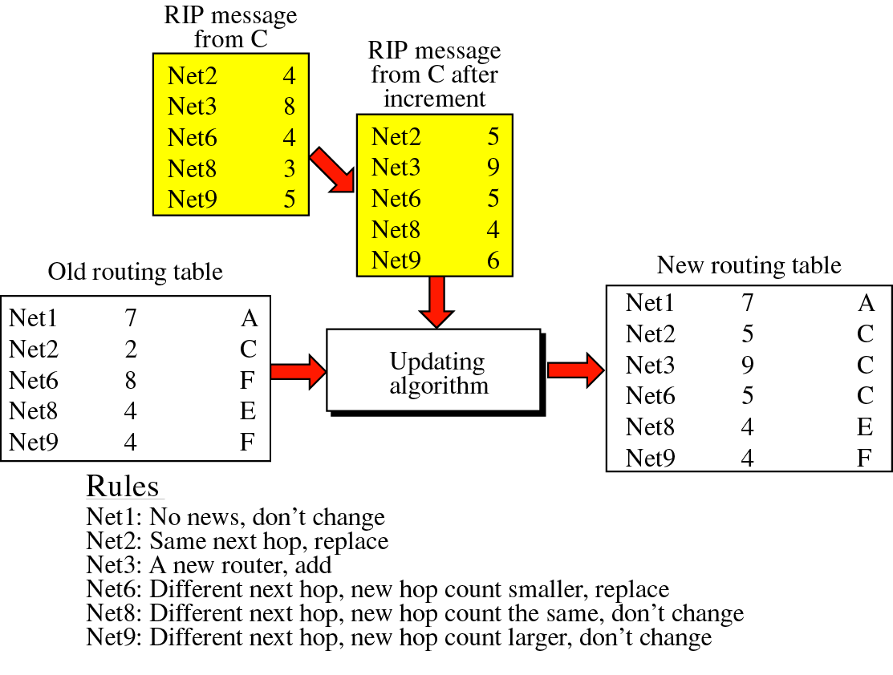
RFC1058：
发送时 unchanged
接收时 Metric + 1
某些实现：
发送时 Metric + 1
接收时 unchanged

Slide 26
Network Discovery
路由表：
目的网络 | 下一跳 | 发送接口 | Metric
N1
A
N2
B
N3
C
N4
1
2
1
2
1
2
B: (N2,1) (N3,1)
(N1,2) (N4,2)
A: (N1,1) (N2,1) (N3,2)
B: (N2,1) (N3,1)
(N1,2) (N4,2)
A: (N1, 1) (N2, 1)
C: (N3,1) (N4,1) (N2,2)
B: (N2,1) (N3,1)
(N1,2) (N4,2)
C: (N3, 1) (N4, 1)
A:(N1,1)(N2,1)(N3,2)(N4,3)
B: (N2,1) (N3,1)
(N1,2) (N4,2)
C:(N3,1)(N4,1)(N2,2)(N1,2)
B: (N2, 1) (N3, 1)
B: (N2, 1) (N3, 1)
N1 | - | 1 | 0
N2 | - | 2 | 0
N2 | - | 1 | 0
N3 | - | 2 | 0
N3 | - | 1 | 0
N4 | - | 2 | 0


N3
B1
2
1
N1
A2
1
1
N2
B2
1
1


N4
B1
2
2
N4
C1
2
1
N1
B2
1
2
●
●

Slide 27
Topology Change
N1
A
N2
B
N3
C
N4
1
2
1
2
1
2
A: (N1,1) (N2,16)
(N3,16) (N4,16)
B: (N2,16) (N3,1)
(N1,16) (N4,2)
C: (N3,1) (N4,1)
(N2,16) (N1,16)
N1 | - | 1 | 0
N2 | - | 2
∞
N2 | - | 1
N3 | - | 2 | 0
N3 | - | 1 | 0
N4 | - | 2 | 0
0


∞
0

N3
B1
2
∞
∞
∞
1
N1
A2
1
1
N2
B2
1
1
N4
B1
2
∞
∞
2
N4
C1
2
1
N1
B2
1
2

Slide 28
11.3.3 Timers in RIP
实现中：
P＝25 ~ 30 s
G＝60 or 120 s
Timers
Periodic
30 s
(for each router)
Expiration
180 s
(for each route)
Garbage collection
120 s
(for each route)
25~35 s
180 s
120 s
E = 180 s
E = 180 s
Metric 16
G = 120 s
删除
路由
Notes:
1.更新计时器（update）：30S更新路由表；2.无效计时器（invalid）：180S不刷新则将该路由条目的度量值设置为16；
3.刷新计时器（flush）：默认240S，比无效计时器长60S，刷新后路由条目则删除；4.抑制计时器（Hold-down）：180S。

Slide 29

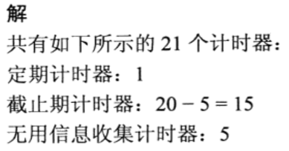
11.3.3 Timers in RIP

Slide 30
11.3.4 RIP Version 2
Message format
Operation
Support VLSM and classless addressing: subnet mask
Authentication: Family = 0xFFFF
Multicasting: 224.0.0.9
Encapsulation: UDP ( port 520 )
Command
Version
All 0s
Family
Route Tag
IP address
Subnet Mask
Next Hop
Metric
Notes:
Family = 0xFFFF时，报文为专门的鉴别信息，16字节，同时Route tag字段被替换为鉴别类型 指明鉴别的协议
Multicasting 224.0.0.9 (all-router,全路由器)用来把报文传送给路由器，而不用包含主机

Slide 31
Route Tag
路由标记
To provide a method of separating "internal" RIP routes (routes for networks within the RIP routing domain) from "external" RIP routes, which may have been imported from an EGP or another IGP
RIPv2
OSPF
N1
IR1
IR2
IR3
XR1
N2, N3
Dest. | Next | Tag
N1 | IR1 | 1
N2 | IR3 | 2
N3 | IR3 | 2

Slide 32
RFC2453 - Appendix A: Next Hop Field in a rip entry
RIPv2
OSPF
IR1
IR2
IR3
XR1
XR2
XR3
Assume the best routes
XR1 → N1/N2; XR2 → N3/N4/N5; XR3 → N6/N7
XR1 exchange RIPv2 routes with IR1/IR2/IR3, setting the Next Hop field
0.0.0.0 for N1/N2
XR2 for N3/N4/N5
XR3 for N6/N7
Notes:
Next hop指明下一跳必须发往的地址，无论是否在一个AS内

Slide 33
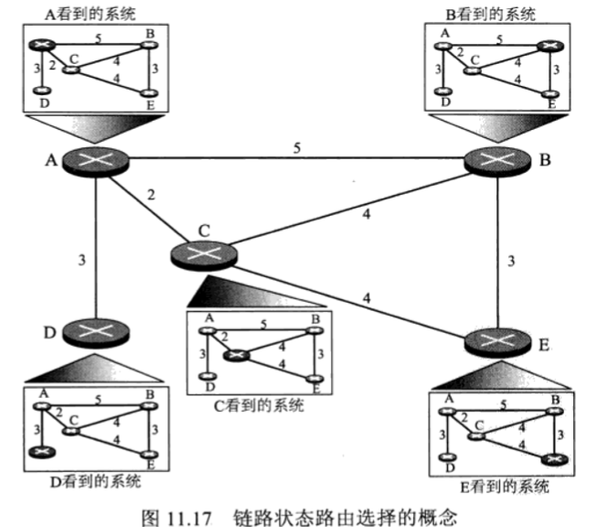
11.4 Link State Routing
Notes:
每个结点掌握全局信息，通过每个结点贡献自己的局部知识，来构建全局知识，就像共用一个地图，每个人的位置不同，走的路径也不一样

Slide 34
11.4 Link State Routing
Initialization
States of directed links
Sharing the knowledge about the internet
What the state of its neighborhood ( LSA )
Where with every other router ( flooding )
When there is a change ( event-driven )
Updating the routing table
Dijkstra algorithm: SPF tree → Routing table
The idea —— 提供一张公路线路图！
Every router should have the whole “picture” of the internet
Notes:
拓扑必须是动态更新的，如何扩展到全局？四组动作:LSA, flooding, SPF tree → Routing table

Slide 35
11.4.1 Link and Link-State
Link
A connection
Link-state
The interface of a router and its relationship to its neighboring routers
A directed graph（有向图）
Vertices: routers and networks
Edge: connect 2 router
or connect a router to a network
Notes:
有向图，同一个链路两个方向的代价是不同的

Slide 36
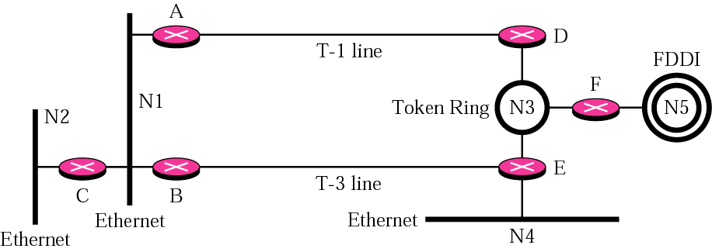
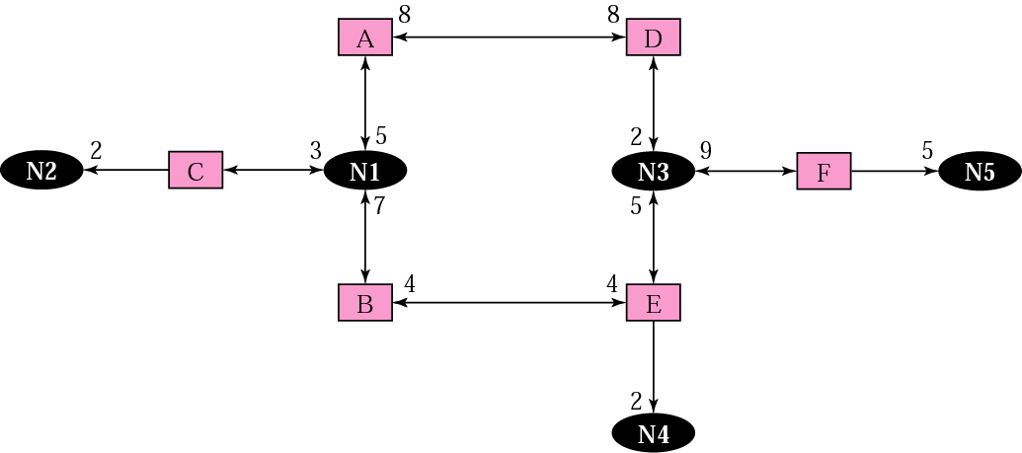
3
2
2
3
2
5
3
5
Link state knowledge
Metric: cost, 代价
The output side of each router interface
Ex. OSPF: 10⁸ / bandwidth
2

Slide 37
11.4.2 Flooding
LSP —— IS-IS
Link State Packet，链路状态分组
IS-IS
LSA —— OSPF
Link State Advertisement，链路状态通告
A Link State Update ( LSU ) packet may contain several distinct LSAs
To reliable floods each LSA one hop further from its point of origination

Slide 38
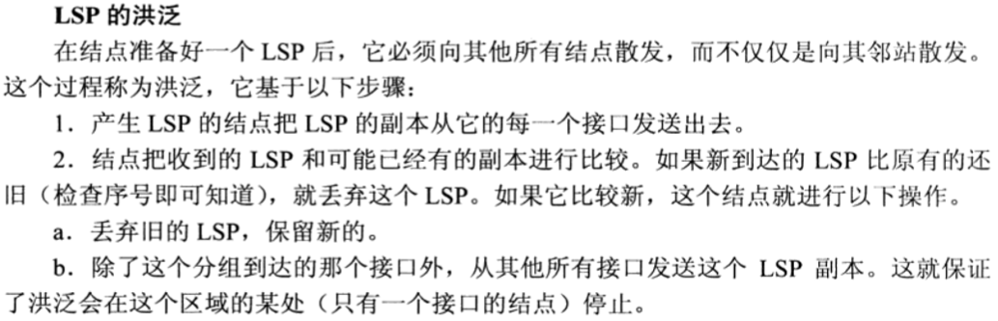
11.4.2 Flooding

Slide 39
Reliable Flooding LSA
Each newly received LSA must be acknowledged
Explicit: Link State Acknowledgment (LSAck) packets
Implicit: LSU packets
Many ACKs may be grouped together into a single LSAck packet
Determining which LSA is newer, then flooding the new (and more recent) LSA out some set of the router's interfaces
LS sequence number → LS checksum→ LS age
larger larger smaller
Retransmitting LSAs until they are acknowledged
Retransmissions interval is a configurable per-interface value

Slide 40
11.4.3 Dijkstra Algorithm
Calculating a tree of shortest paths with the router itself as root
Divides the nodes into 2 sets
Tentative（临时）
if pass the criteria
Permanent（永久）
Notes:
收到所有的LSP后，各个结点就会有一个完整拓扑的副本，但要找到到其它所有结点的最短路径，还需要使用最短路径树SPT

Slide 41
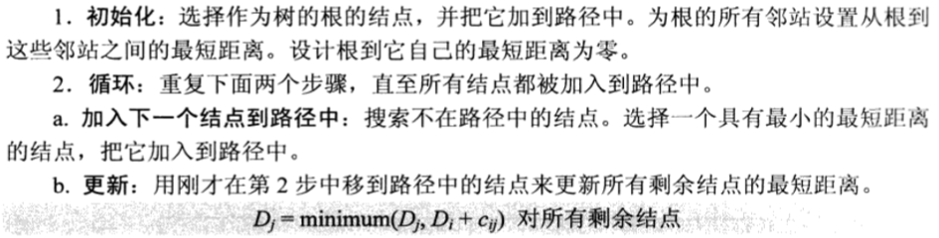
11.4.3 Dijkstra Algorithm

Slide 42
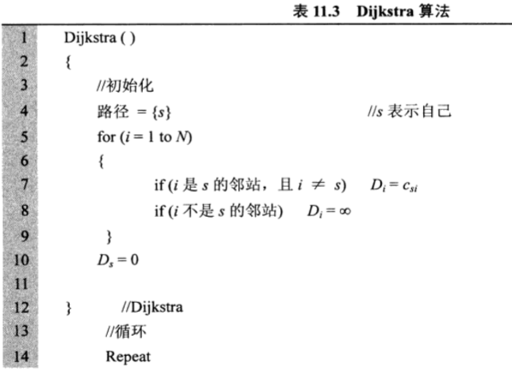
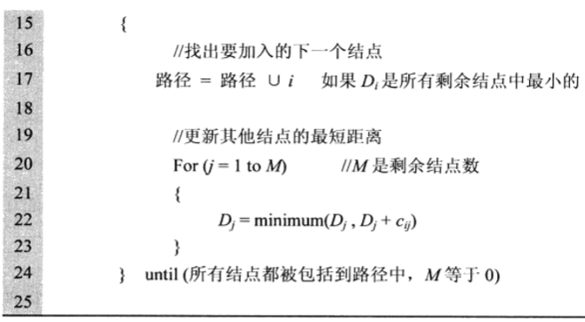
11.4.3 Dijkstra Algorithm

Slide 43
SPF Algorithm Example
兰色表示路径{s}
(2, A)
(8, B)
6
B
C
2
3
3
2
(4, B)
1
A
E
F
(5, B)
D
7
2
(9, B)
2
2
G
4
H
(6, B)
(7, B)
∞
节点 | Cost | 路径 | E
B |  |  | F
C |  |  | G
D |  |  | H
4
A-B-E
2
A-B
∞
5
A-B-E-F
∞
8
8
A-B-C
A-B-E-F-C
7
6
A-G
A-B-E-G
∞
∞
9
A-B-E-F-H-D
7
A-B-E-F-H
11
A-B-C-D
10
A-B-E-G-H
Notes:
兰色表示路径{s}

Slide 44
Build a Routing Table Based the SPF Tree
(2, A)
(8, B)
6
B
C
2
3
3
2
(4, B)
1
A
E
F
(5, B)
D
7
2
(9, B)
2
2
G
4
H
(6, B)
(7, B)
Node | Cost | Next | Node | Cost | Next
B | 2 | － | F | 5 | B
C | 8 | B | G | 6 | B
D | 9 | B | H | 7 | B
E | 4 | B

Slide 45
11.5 OSPF
Open Shortest Path First，OSPF
v2：RFC 2328，开放最短路径优先
Application
Layer
OSPF
软件实现层次
Transport
Layer
TCP
UDP
89
Network
Layer
ICMP
IGMP
IP
ARP
RARP
Network
Access Layer
LANs
MANs
WANs

Slide 46
11.5.1 Areas
Advantages
Reduce link state advertisements overhead
Reduce frequency of SPF calculations
Smaller routing tables
Routing
Intra-area routing
Inter-area routing

Slide 47
OSPF Area
A collection of networks, hosts, and routers all contained within an AS
Area 1
Area 2
To
other
ASs
Area 0 (backbone)
Autonomous System

Slide 48
Area 0
Backbone area
Be responsible for distributing routing information between non-backbone areas
Must be contiguous
NOT need be physically contiguous
Virtual link
Area 1
Area 2
Area 0
Area 3
Area 0
Area 3
Area 0
Area 1
Area 2

Slide 49


OSPF Router Types
Internal router
Backbone router
Area Border Router, ABR
AS Border Router, ASBR
IR
Area 1
Area 2
ABR，BR
ASBR，BR
To other
AS
Area 0 (backbone)
Autonomous System
IR，BR

Slide 50
11.5.2 Network’s Type
Point-to-point network，点到点网络
Stub network，残桩网络
Transit network，转接网络
Broadcast
NBMA
Frame Relay
X.25

Slide 51
Transit Network: DR and BDR
Designated router & backup DR —— a true router
指定路由器 & 备份指定路由器
Purpose
Reduce the number of adjacencies required on a broadcast or NBMA network
Reduce the amount of routing protocol traffic and the size of the link-state database
Example: there are N routers on a transit network
If no DR
Each router has ( N-1 ) neighbors
If there is a DR
Each non-DR has only 1 neighbor
DR has ( N-1 ) neighbors

Slide 52
11.5.3 OSPF LSA Types
Intra-area
Type 1: Router–LSA
Type 2: Network–LSA
Inter-area
Type 3: Summary–LSA
Type 4: Summary–LSA
External
Type 5: AS–external–LSA

Slide 53
Intra-area LSAs
Type 1: Router–LSA
Originated by all routers
Describes the collected states of the router’s interfaces to an area
Flooded throughout a single area only
Type 2: Network–LSA
Originated for broadcast and NBMA networks by the DR
Contains the list of routers connected to the network
Flooded throughout a single area only

Slide 54
Inter-area LSAs
Type 3: Summary–LSA
Originated by ABRs
Describes routes to networks outside the area
Flooded throughout the LSA’s associated area
Type 4: Summary–LSA
Originated by ABRs
Describes routes to ASBRs
Flooded throughout the LSA’s associated area

Slide 55
External LSAs
Type 5: AS–external–LSA
Originated by ASBR
Describes a route to a destination in another AS
Flooded throughout the AS except the stub area

Slide 56
OSPF LSA Example
AS 20
Type 1
(X=ASBR)
Type 5
(AS 20)
Type 2
(Area 1)
Type 4
(X=ASBR)
Type 4
(X=ASBR)
Type 3
(Area 0)
Type 3
(Area 0)
Type 5
(AS 20)
Type 5
(AS 20)
Type 1
(Area 1)
Area 0
DR
Type 1
(Area 1)
Type 3
(Area 1)
Type 3
(Area 1)
Type 3
(Area 0)
Type 1
(Area 1)
Type 1
(Area 0)
Type 4
(X=ASBR)
Type 1
(X=ASBR)
Type 5
(AS 20)
Type 5
(AS 20)
Type 1
(Area 0)
Type 2
(Area 1)
Type 2
(Area 1)
Type 3
(Area 1)
Type 3
Default
Area 1
Area 2
(Stub)
AS 10

Slide 57
11.5.4 OSPF Databases
Adjacency database
All the neighbors to which a router has established bidirectional communication
Unique for each router
Link-state database
The relationship between each router and its neighbors
All routers within an area have identical link-state databases
Forwarding database ( routing table )
The routes generated when an SPF algorithm is run on the link-state database
The routing table on each router is unique

Slide 58
11.5.5 OSPF Packets
Format
Multicasting: 224.0.0.5, 224.0.0.6
Encapsulation: IP ( protocol 89 )
Version
Type
Packet Length
Router ID
Header
Area ID
Checksum
Authentication Type
Authentication
Authentication
OSPF Packet Data

Slide 59
Packet Types
1: Hello packet
A 64-byte packet sent periodically to keep a link “alive”
2: DBD ( Database Description )
Summary contents of a router’s link-state database sent to a newly discovered neighbor
3: LSR ( Link-State Request )
Requests more specific information about a link from a neighbor’s link-state database
4: LSU ( Link-State Update, LSA )
Transports LSAs to neighbor routers, a reply to an LSR
5: LSAck ( Link-State Acknowledgement )
Ack receipt of a LSA; OSPF’s routing updates are connection-oriented

Slide 60
LSU Packet Format
OSPF common header
24 bytes, Type = 4
# LSAs ( 1 byte )
LSAs
(any combination of different kinds)
Repeated

Slide 61
LSA Format
LS age
Options
LS type
Link state ID
Header
Advertising Router ID
LS sequence number
LS checksum
length
LSA data

Slide 62
Router ID
A 32-bit number assigned to each router running the OSPF protocol
Uniquely identifies the router within an AS
Implementation strategy: to use the largest or smallest IP interface address assigned to the router
Route ID —— in OSPF packet header
The Router ID of the packet's source
Advertising Router ID —— in LSA header
The Router ID of the router that originated the LSA

Slide 63
Link State ID & Link ID
Link state ID —— in LSA header
Link ID —— in Router-LSA ( type 1 LSA )
LS type | Link State ID
1: router-LSA | The originating router's Router ID
2: network-LSA | The IP interface address of the network's DR
3: summary-LSA | The destination network's IP address
4: summary-LSA | The Router ID of the described ASBR
5: AS-external-LSA | The destination network's IP address
Link type | Link State ID
1: Point-to-point link | Neighbor Router ID
2: link to transit network | Interface address of DR
3: link to stub network | IP network address
4: virtual link | Neighbor Router ID

Slide 64
11.5.6 OSPF Operation
1. Establish router adjacencies
Done with the exchange of Hellos
2. Elect the DR / BDR ( if necessary )
Done on multiaccess network only
3. Discover routes
Done in the ExStart and Exchange states
4. Select appropriate routes
Done through the calculation of SPF algorithm
5. Maintain routing information
Done through the regular exchange of Hellos

Slide 65
OSPF States
Down: Not exchange information with any neighbor
Init: When an interface receives its first Hello
2-way: When it sees itself in a neighbor’s Hello
ExStart: Two neighbors use Hello to negotiate who is the “master” and who is the “slave”
Exchange: Neighbors use DBD to send each other a summary of their link-state database
Loading: Uses LSR, LSU, and LSAck to get complete link-state information
Full: Neighbors are fully adjacent

Slide 66
Step 1. Establish router adjacencies
172.68.5.1/24
E0
172.68.5.2/24
E1
A
B
Down State
39547439070713
39547439070713
I am router ID 172.68.5.1 and I see no one
Hello
Init State
Router B 邻接表
172.68.5.1/24, int E1
I am router ID 172.68.5.2, and I see 172.68.5.1
39547439070713
39547439070713
Hello
Router A 邻接表
172.68.5.2/24, int E0
Two-way State

Slide 67
Step 3. Discover routes
A
B
Exstart
Hello Packet
Hello Packet
Exchange
DBD Packet
DBD Packet
LSAck Packet
LSAck Packet
Loading
LSR Packet
LSU Packet
LSAck Packet
Full

Slide 68
11.5.7 RIP vs. OSPF
对网络拓扑的了解
路由计算方法
路由更新方式
路由更新内容
收敛速度
适用环境

Slide 69
11.6 Path Vector Routing
Path vector routing
The AS boundary routers advertise the reachability of the networks in their own ASs to neighbor AS boundary routers
Policy routing
Choose the best path for reaching the destination based on the value of path attributes

Slide 70
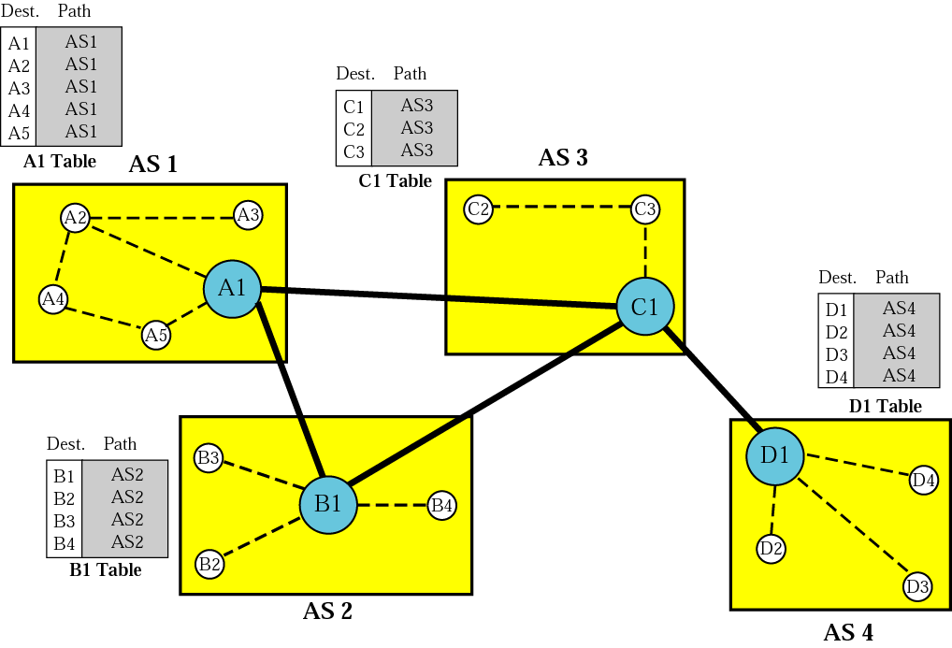
Initial Routing Tables
AS 1
AS 3
AS 2
AS 4

Slide 71
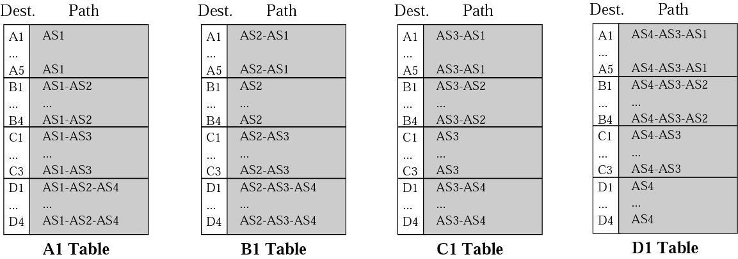
Stabilized Routing Tables
A2
A3
C2
C3
A4
A1
C1
AS4
AS3
AS1
A5
D1
D4
B1
B4
B3
B2
D2
D3
AS2
3
3

Slide 72
Path Vector Routing Table
Path
An ordered list of ASs that a packet should travel through to reach the destination
Example
Loop prevention
Network | Next Router | Path
N01 | R01 | AS14, AS23, AS67
N02 | R05 | AS22, AS67, AS05, AS89
N03 | R06 | AS67, AS89, AS09, AS34
N04 | R12 | AS62, AS02, AS09

Slide 73
11.7 BGP-4
Border Gateway Protocol，BGP
v4：RFC 1771，RFC 1772，边界网关协议
Application
Layer
BGP-4
软件实现层次
179
Transport
Layer
TCP
UDP
Network
Layer
ICMP
IGMP
IP
ARP
RARP
Network
Access Layer
LANs
MANs
WANs

Slide 74
11.7.1 Types of AS
Single-homed AS
Only one exit point to the outside
Example: AS 1, AS 3
Multi-homed AS
More than one exit point to the outside
Example: AS 2
Nontransit AS
not allow transit traffic to pass through it
Transit AS
allow transit traffic to pass through it
AS 1
AS 2
R
R
R
R
AS 3

Slide 75
When to and not to Use BGP
Figure A
A single-homed AS does NOT usually need BGP, uses default route
Figure B
Even if an AS has redundant paths to its ISP’s POP, BGP is NOT necessarily required
Figure C
An AS with redundancy to the same ISP, but different POPs still does NOT require BGP
Figure D
An AS with multiple ISPs REQUIRES BGP
Custom
AS
ISP
AS 1
A
Custom
AS
ISP
AS 1
B
BGP must be used to implement
external routing policies.
ISP
AS 1
Custom
AS
C
ISP
AS 1
ISP
AS 1
Custom
AS
D
ISP
AS 2

Slide 76
11.7.2 IBGP & EBGP Sessions
EBGP
AS 2
AS 1
R
R
IBGP
R
R
EBGP
IBGP
EBGP
AS 3
R
R
IBGP
AS 3
R
EBGP

Slide 77
Synchronization Rule
Non-BGP
Router
Example
A BGP router (A) can not advertise routes (15.1.1.0) learned from an IBGP peer (B) to other BGP peers unless the local router (C) also has learned about the route via an IGP
Router C has not learned about 15.1.1.0 via an IGP
C
AS 200
17.1.1.0
AS 100
10.1.1.0
AS 300
15.1.1.0
A
B
IBGP

Slide 78
11.7.3 BGP Path Attributes
Form: < type, length, value >
Types
Well-known mandatory
Example: ORIGIN (1), AS_PATH (2), NEXT_HOP (3)
Well-known discretionary
Example: LOCAL_PREF (5), ATOMIC_AGGREGATOR (6), AGGREGATOR (7)
Optional transitive
Optional non-transitive
Example: MULTI_EXIT_DISC (4)

Slide 79
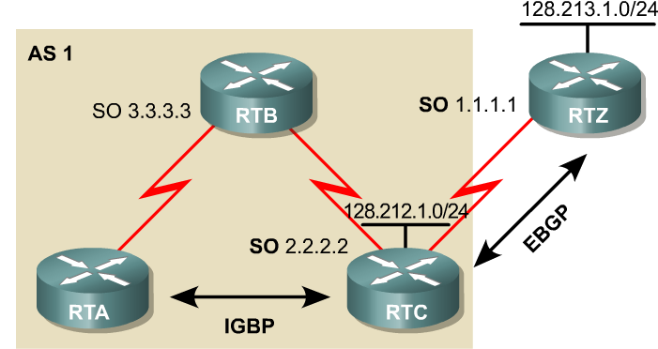
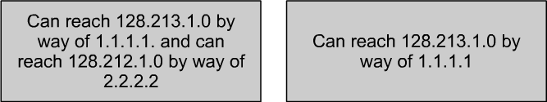
NEXT_HOP Example

Slide 80
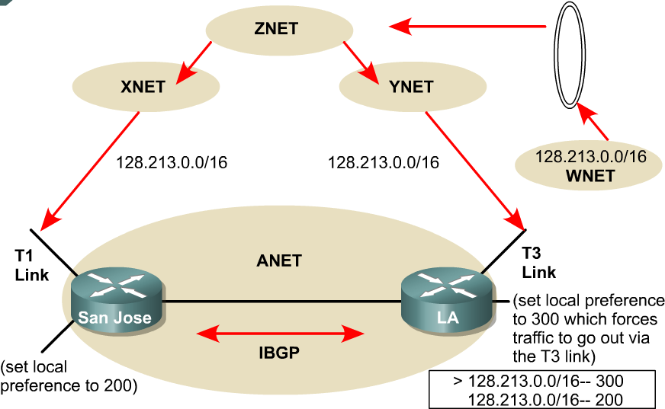
LOAD_PREFERENCE Example
ANET will prefer LA to the network 128.213.0.0/16

Slide 81
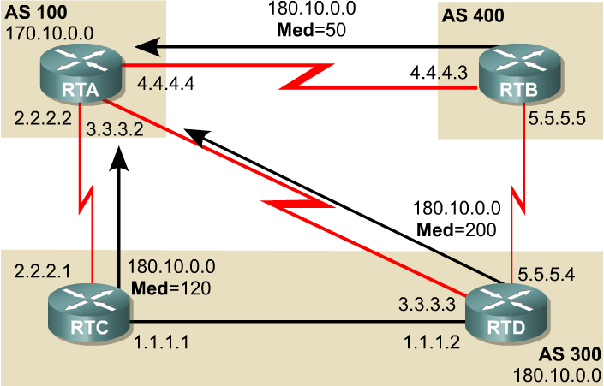
MED Example
RTA will prefer RTB to the network 180.10.0.0/16

Slide 82
11.7.4 BGP Messages
Message header
Encapsulation
TCP ( port 179 ) → unicasting
Maker
（authentication or synchronization）
16 bytes
Length
Type

Slide 83
Message Types
Type 1: OPEN
Establish the peer relationship
Type 2: UPDATE
Advertise reachable or withdrawn routes using NLRI and path attributes
NLRI: network layer reachability information
< length, prefix >
Type 3: NOTIFICATION
Inform the receiving router of errors
Type 4: KEEPALIVE
Interval keeps peer relationship
Recommend: 1/3 Hold Time interval

Slide 84
11.7.5 BGP Operation
Establish the BGP peer relationship
Exchange all candidate BGP routes, including withdraw routes
1.1.1.1
2.2.2.2
Net 6.0.0.0/8, 7.0.0.0/8
Net 4.0.0.0/8, 5.0.0.0/8
Net 4.0.0.0/8
Net 5.0.0.0/8
Withdraw 4.0.0.0/8
Net 6.0.0.0/8
Net 7.0.0.0/8
Net 6.0.0.0/8
Net 7.0.0.0/8
Net 4.0.0.0/8
Net 5.0.0.0/8

Slide 85
BGP Routing Process Model
Routes
received
From
peers
Filtering
Attribute
manipulation
Choosing
the best
route
Filtering
Attribute
manipulation
Routes
sent
to peers
Input
Policy
Engine
Decision
Process
Routes
used by
router
Output
Policy
Engine
BGP
Table
IP Routing
Table

Slide 86
11.8 Summary
路由
静态 vs. 动态
路由协议
类型
IGP：RIP、 OSPF
EGP：BGP-4
操作
路由信息交换：what、 when、where
路由计算

